Slide 1
Unsupervised Anomaly Detection

Slide 2
Outline
Introduction
Main Anomaly Detection Algorithms
Evaluation Methods
Dataset
EDA
Model Results
Visualization of Results
Conclusion

Slide 3
Introduction
UNSW-NB15 dataset of network attacks
A hybrid of real modern normal activities and synthetic contemporary attack behaviours.
49 features and 700000 observations
Anomaly labels and attack types are included
We applied unsupervised methods
Isolation Forest
Local Outlier Factor
DBScan

Slide 4
Isolation Forest
Tree Ensemble Method
Main idea behind:
anomalies are rare, less frequent than normals
anomalies are different than normals
Randomly selecting a feature and randomly selecting a value
Decision Function: Length of the path to isolate a single point at the end node
Anomaly points have shorter path length than normal points

Slide 5
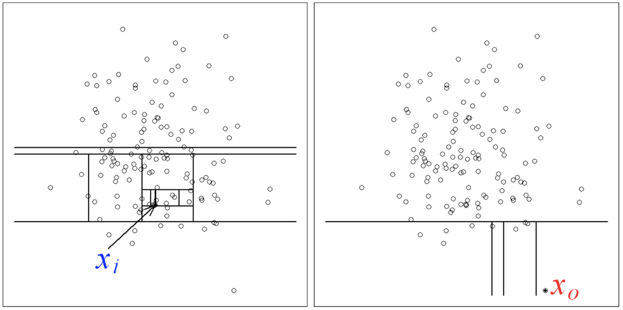
Isolation Forest

Slide 6
Local Outlier Factor
Based on the concept of a local density
Locality is given by k nearest neighbors
Comparing the local density of an object to the local densities of its neighbors
Points that have a substantially lower density than their neighbors are considered to be outliers.

Slide 7
DBScan

Slide 8
Evaluation Methods
Supervised Methods
Recall Score
Contingency Table
Unsupervised Methods
Silhouette Score: a measure of distance of a single sample between other points within the cluster and with the points of nearest cluster
calinski_harabasz_score: ratio between the within-cluster dispersion and the between-cluster dispersion.dispersion is defined as the sum of distances squared
davies_bouldin_score: average similarity measure of each cluster with its most similar cluster. clusters which are farther apart and less dispersed will result in a better score.

Slide 9
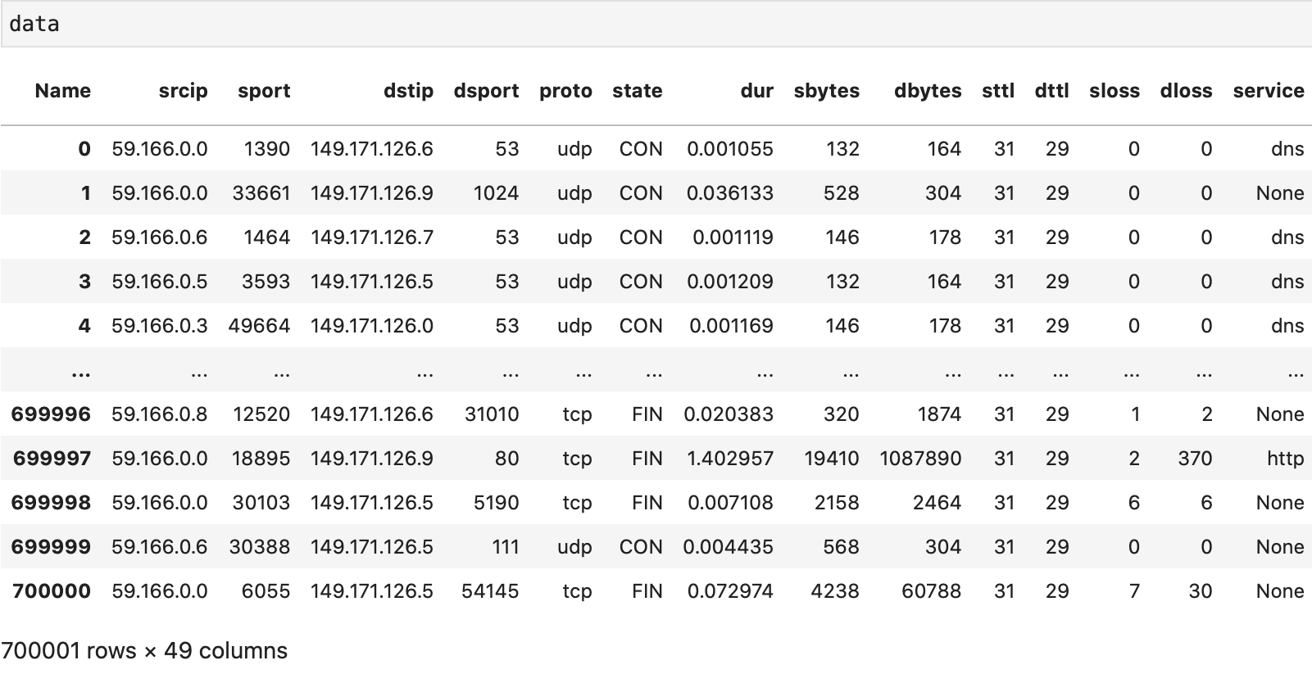
Dataset

Slide 10
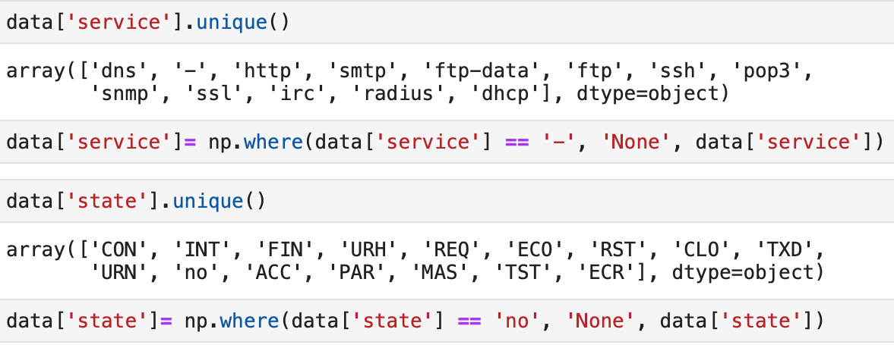
Data Preprocessing

Slide 11
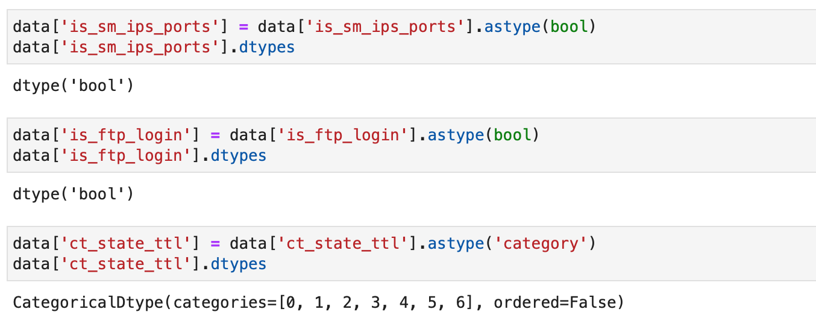
Data Preprocessing

Slide 12

Data Preprocessing

Slide 13
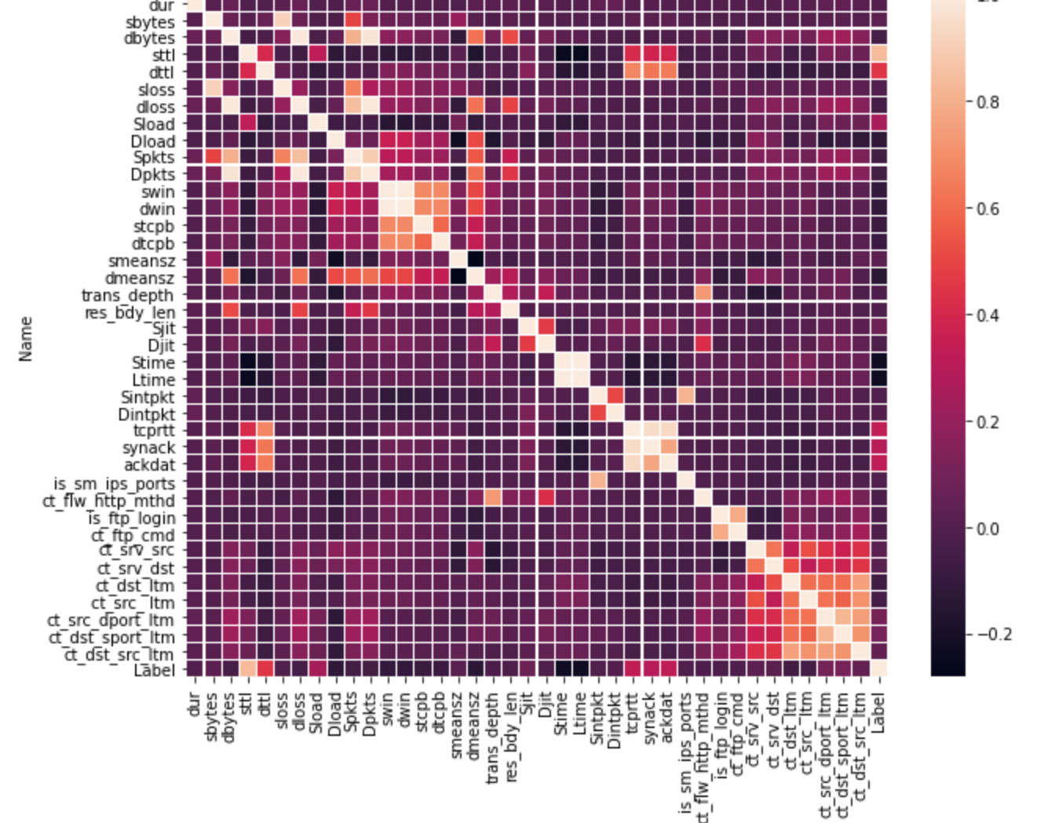

Slide 14
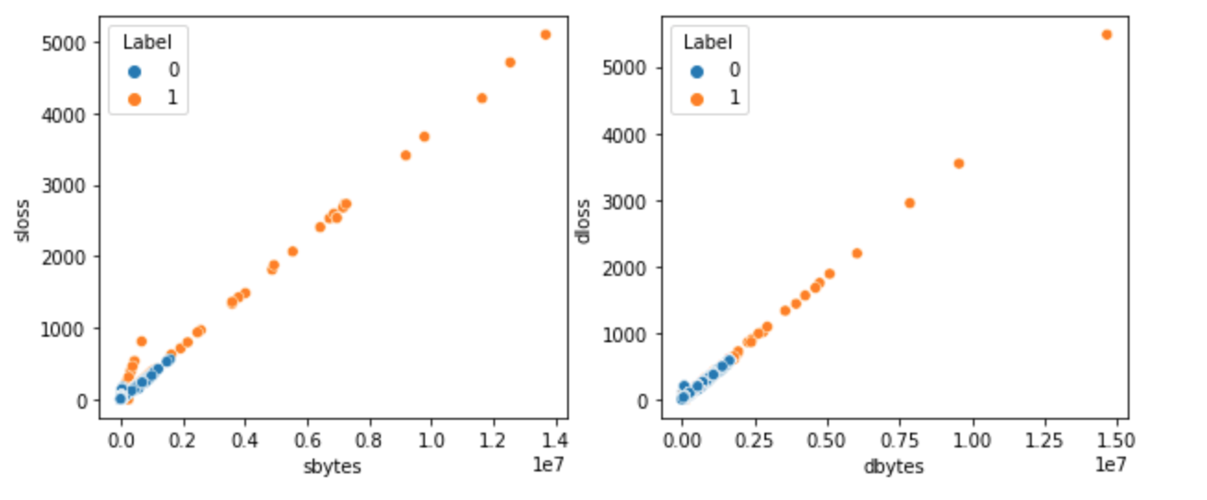
Bivariate Feature Analysis

Slide 15
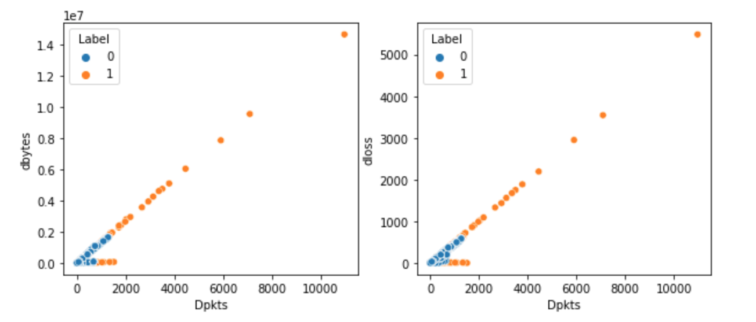
Bivariate Feature Analysis

Slide 16
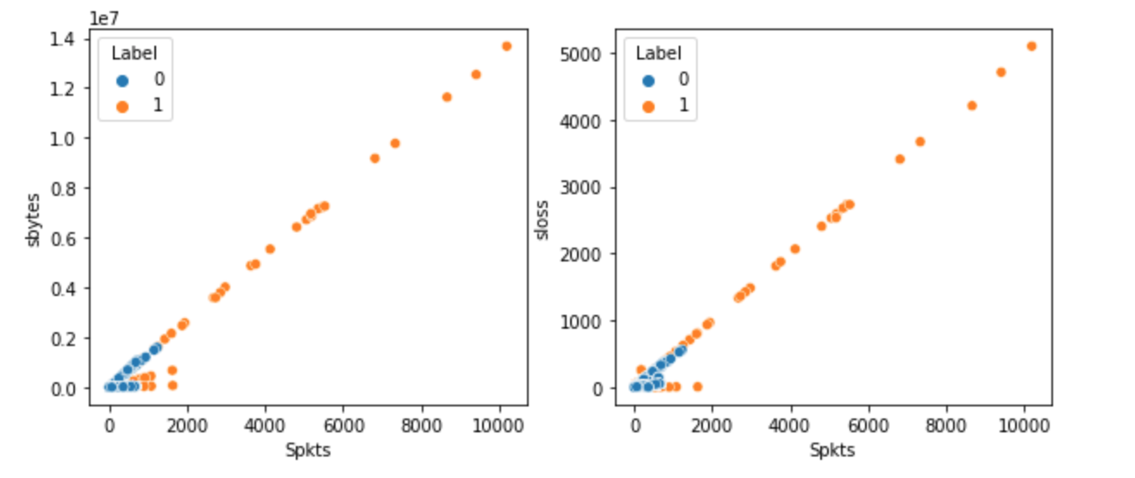
Bivariate Feature Analysis

Slide 17
Experiments
Full Model: All features included
Selected Model: 'sttl', 'sbytes', 'smeansz', 'ct_dst_sport_ltm', ‘service’
Model 1:'sbytes', 'sttl'
Model 2:'sbytes', 'sttl', 'dttl'
Model 3:'sbytes', 'sttl','tcprtt','synack'
Model 4:'sbytes', 'sttl','tcprtt','synack', 'ackdat'
Model 5: 'sbytes', 'sttl','tcprtt','synack', 'ackdat', 'Sload'

Slide 18
Isolation Forest Model
Model | Recall | Prediction | Davies_bouldin | Calinski
Full Model | 0.89 | 0.36 | 4.032 | 14814.348
Selected Model | 0.67 | 0.16 | 3.399 | 34444.326
Model1 | 1 | 0.21 | 1.521 | 170577.335
Model2 | 1 | 0.21 | 1.806 | 118616.591
Model3 | 1 | 0.34 | 1.211 | 388570.030
Model4 | 0.99 | 0.46 | 0.989 | 655861.022
Model5 | 0.99 | 0.39 | 1.080 | 528545.852

Slide 19
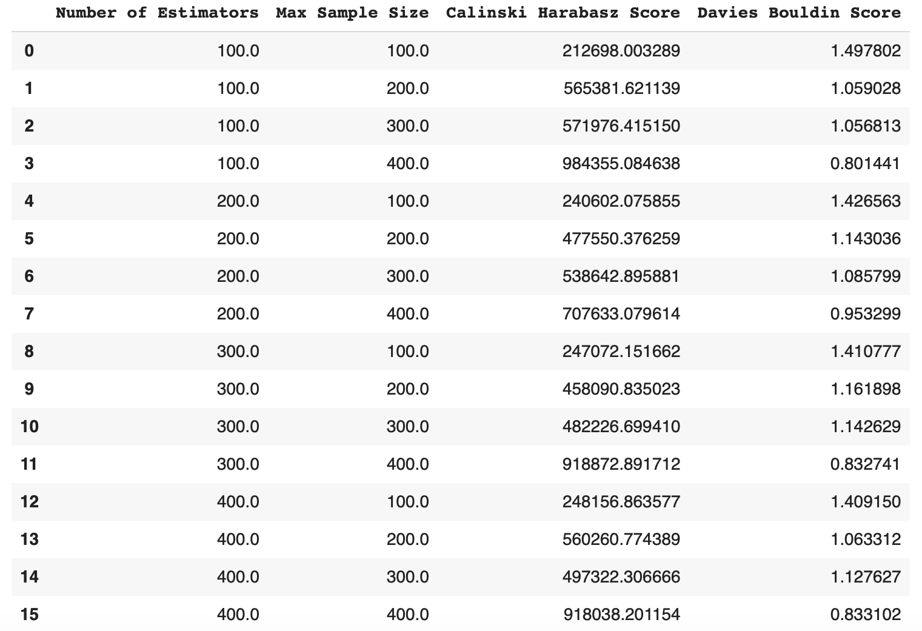
Iso-Forest: Hyperparameter Tuning

Slide 20
Local Outlier Factor

Slide 21
LOF-Hyperparameter Tuning

Slide 22
DBScan

Slide 23
DBScan-Hyperparameter Tuning

Slide 24
Best Results of Algorithms
Algorithm | Model | Parameters | Recall | Precision | Calinski | Davies
Iso Forest | Model4 | n_estimators = 100 max_samples= 400 | 0.9971 | 0.5558 | 984355.084 | 0.801
LOF
DBScan

Slide 25
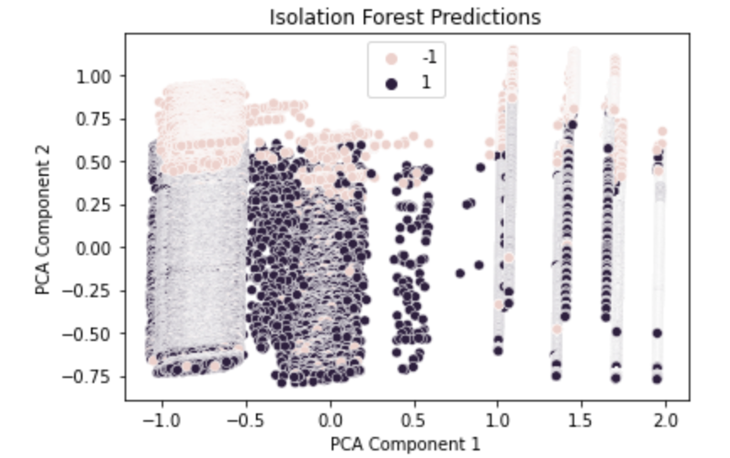
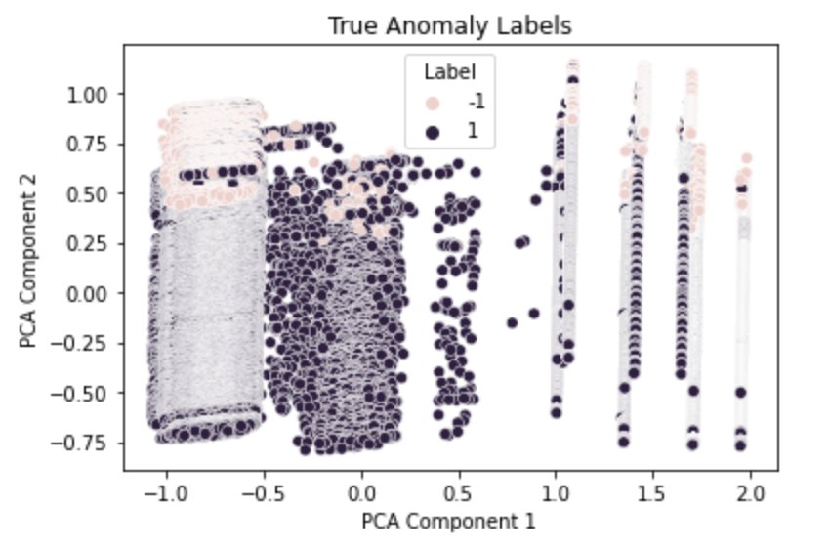
Visualization of Results
Isolation Forest

